Slide 1



Barbara Johnson Stemler
Senior Manager of Access Programs
intrepidmuseum.org/access
bjohnson@intrepidmuseum.org
@bjohnnystemler
@IntrepidMuseum

Slide 2
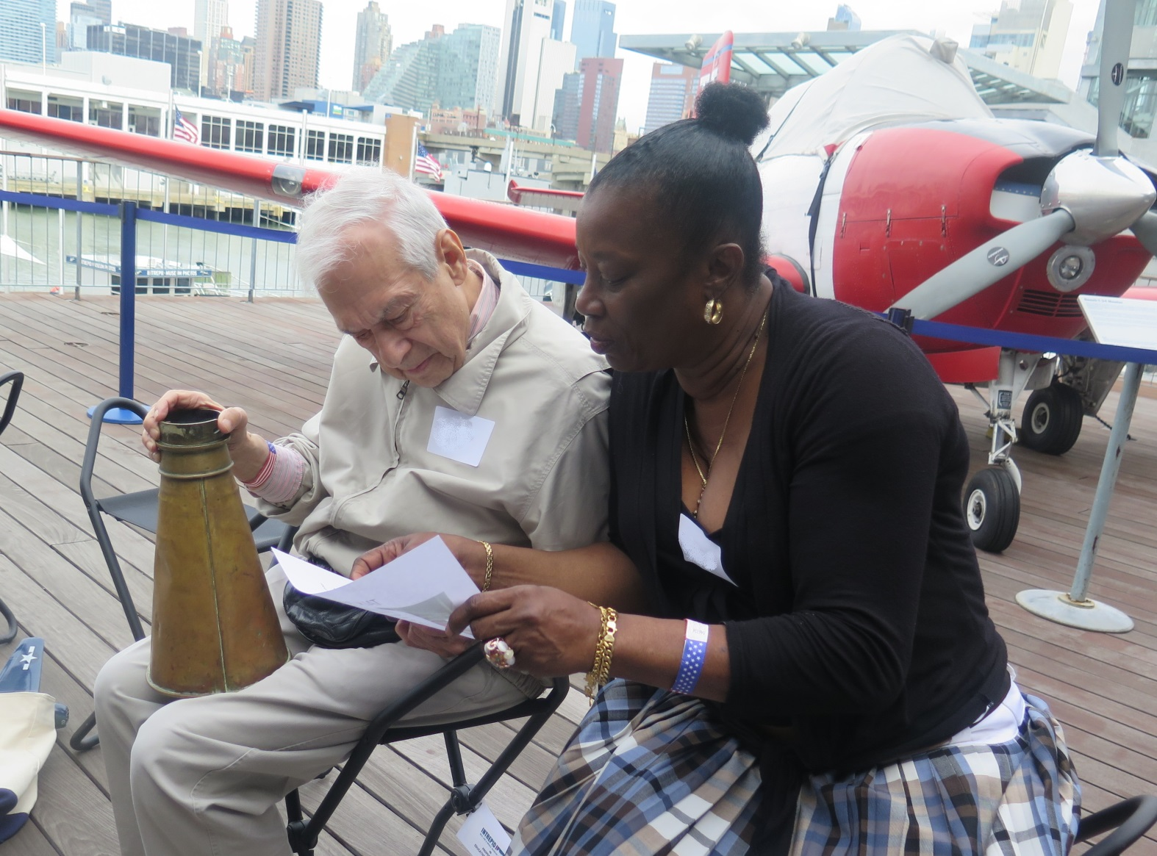
Stories Within

Slide 3
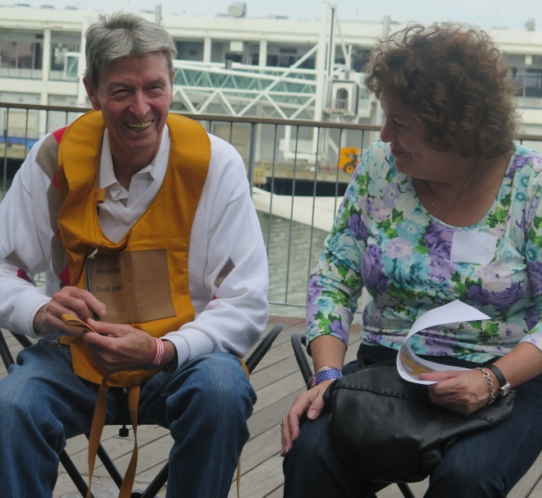

Slide 4
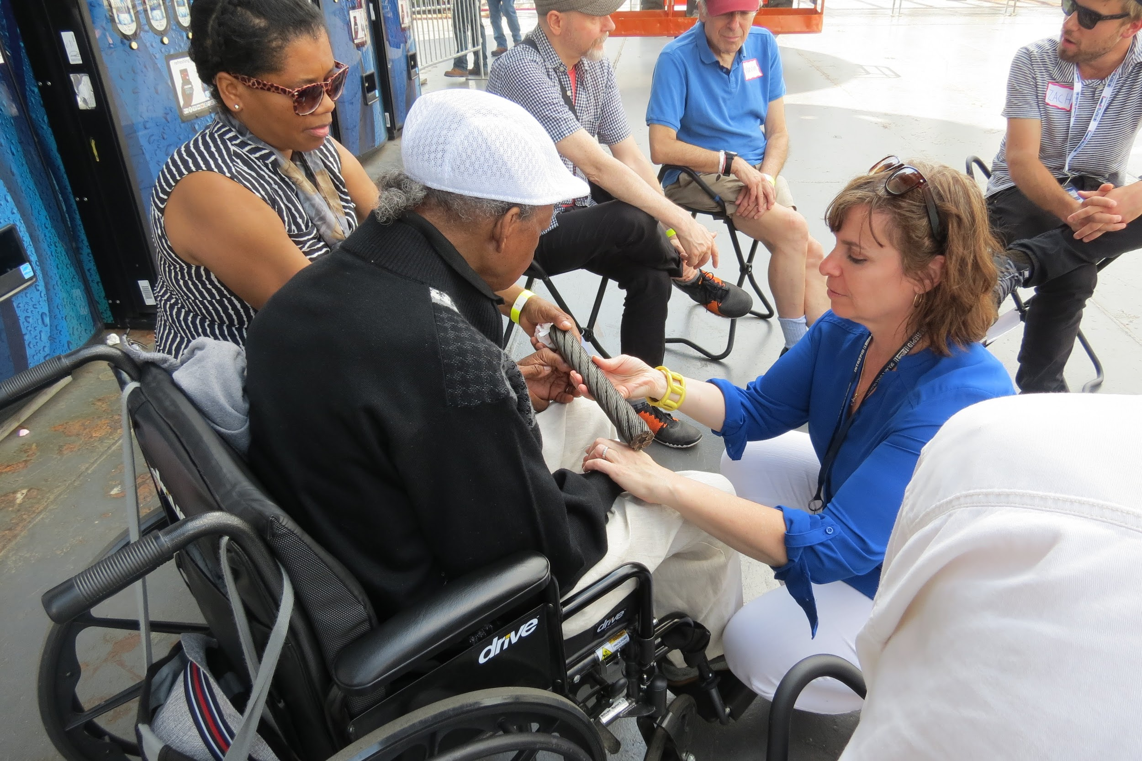

Slide 5
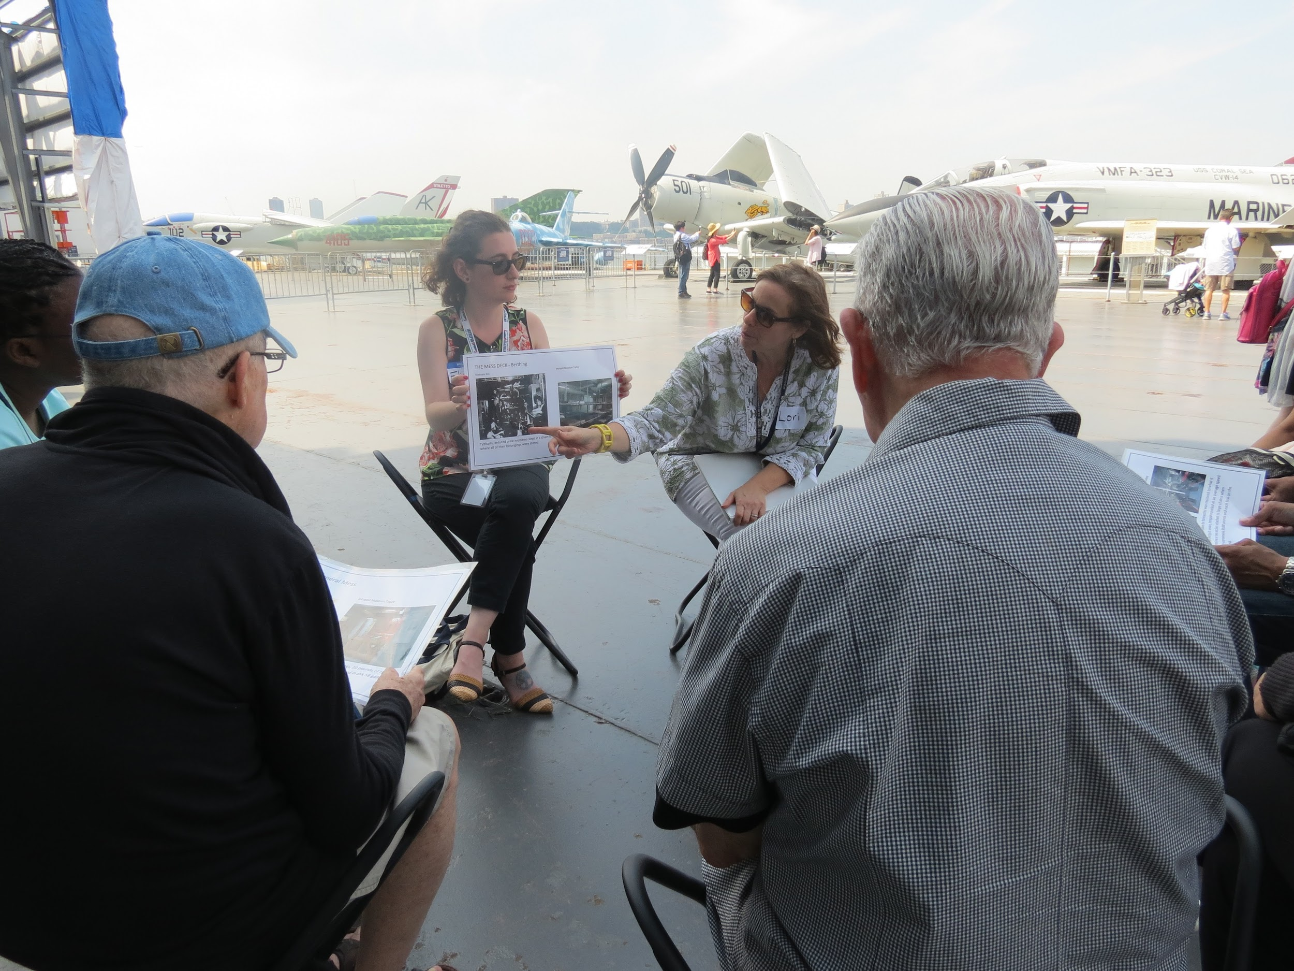

Slide 6
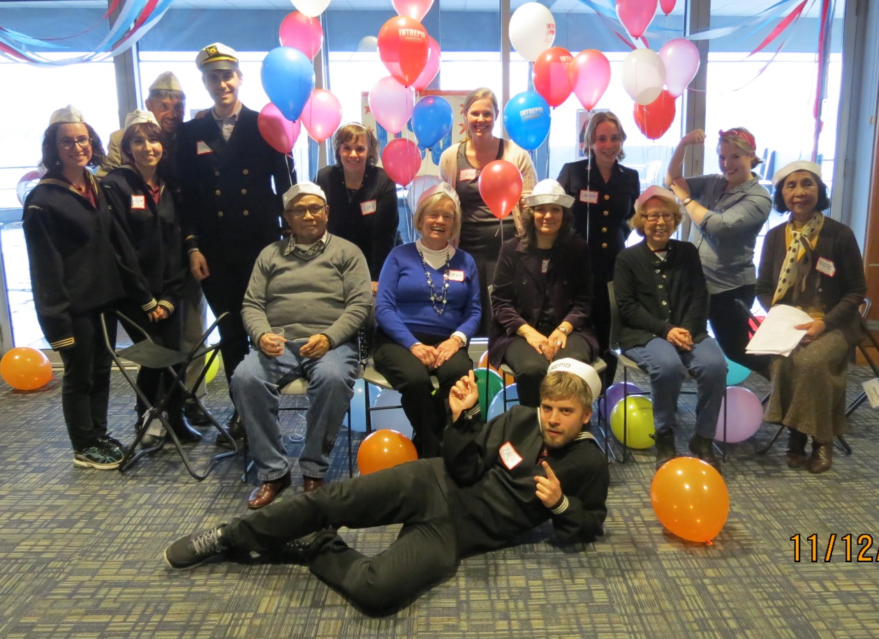
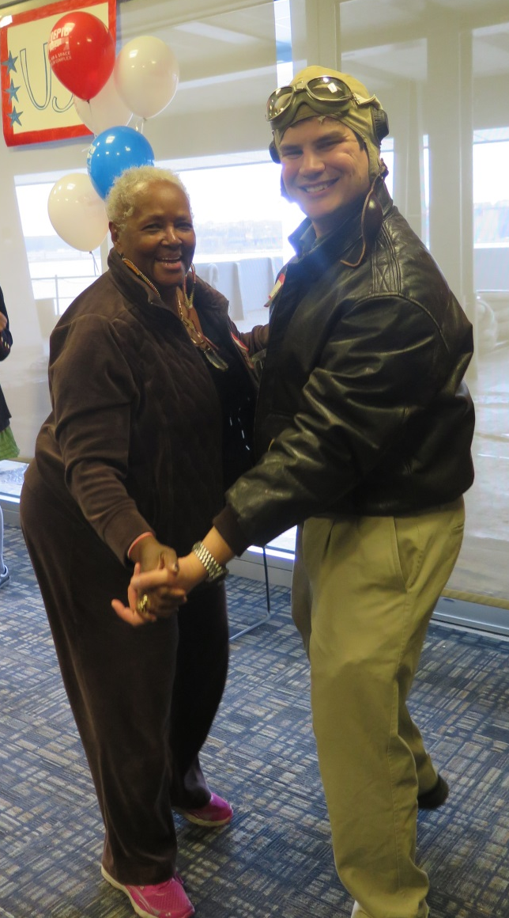
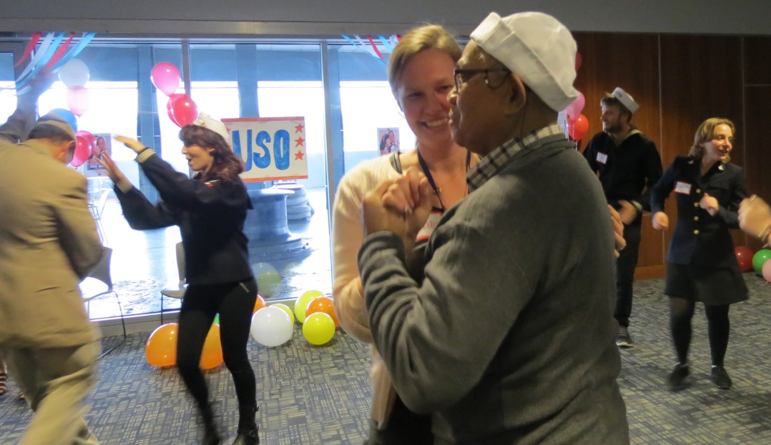
USO Dance

