Slide 1
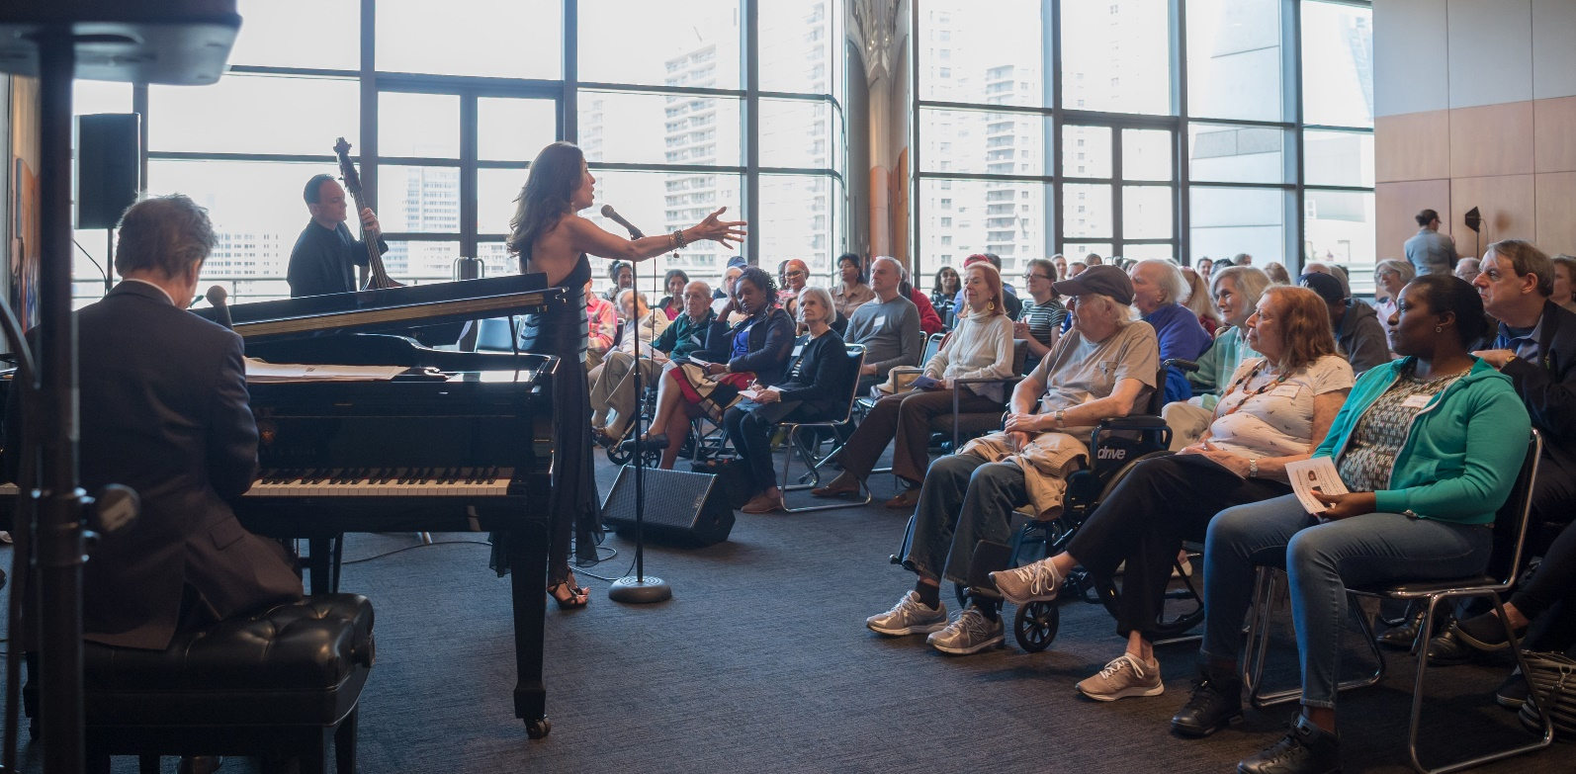
Accessibility at Lincoln Center
Lincoln Center Moments
A performance-based program for people with dementia and their caregivers

Slide 2
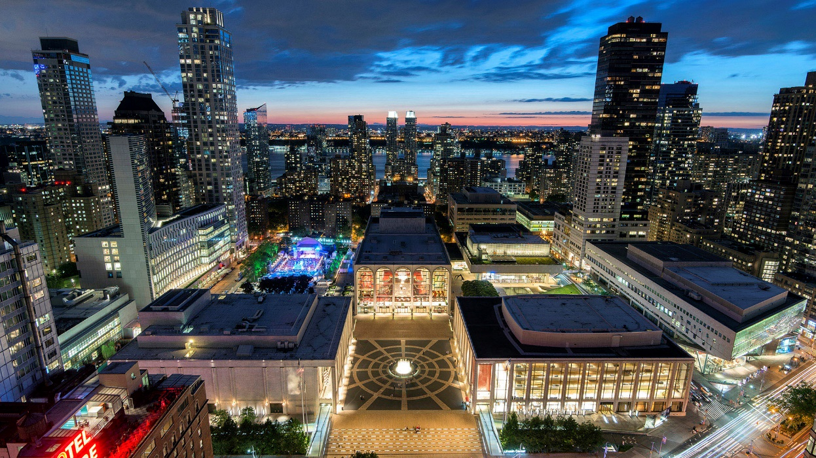
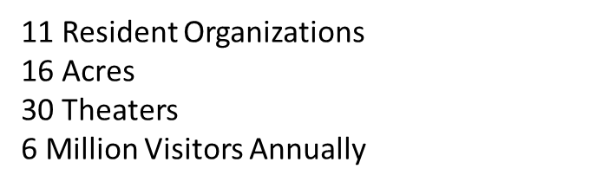
Lincoln Center for the Performing Arts

Slide 3
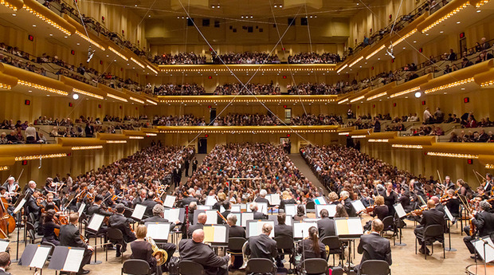
Why?
Aging subscribers
Growing number of New Yorkers with dementia
Successful foundation made, and impact shown, through museum programs

Slide 4
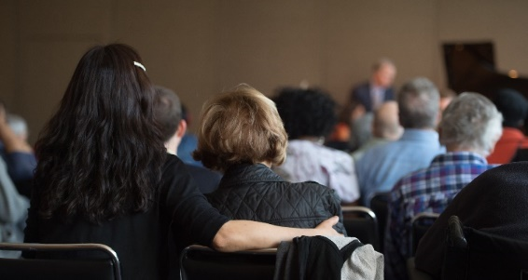
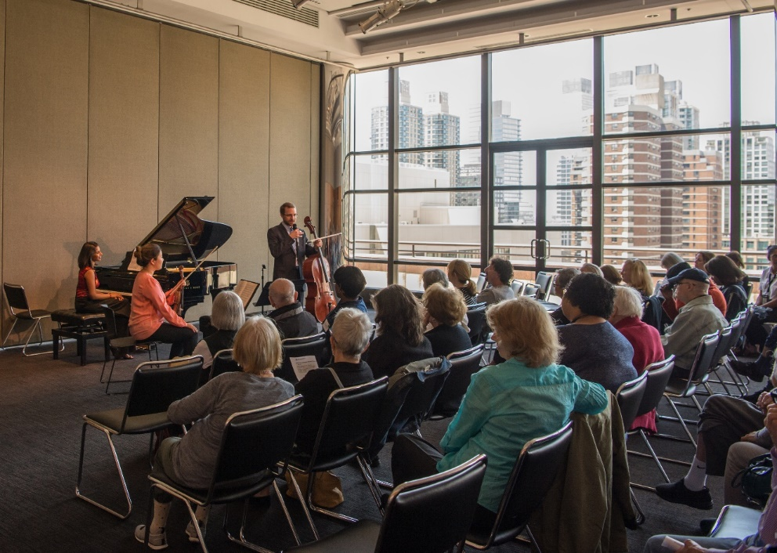
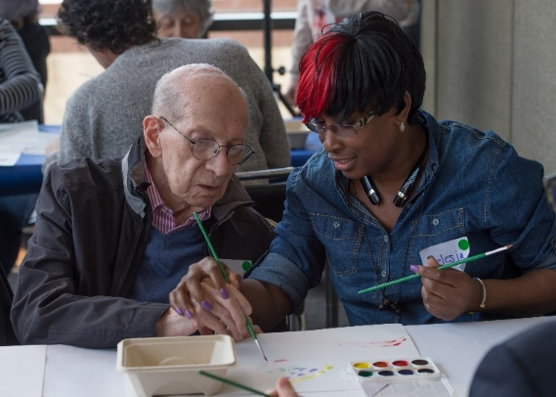
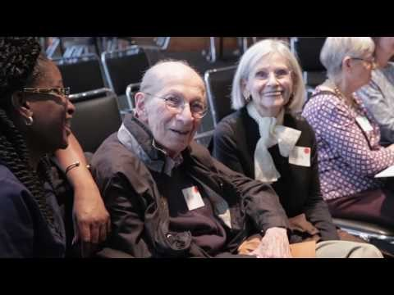
Beyond Accommodations – Supported Performances
Lincoln Center Moments for Individuals with Dementia and their Caregivers

Slide 5
Goals – Pilot and First Season
Pilot Programs – Spring 2016
Performance-based
Accessible
Create time for community-building and reflection
Staff trained and prepared
Spring Season 2017
Reflect diversity of performing arts on campus
Contribute to creative aging field by producing research study on impact
Multi-disciplinary approach to workshops
Set up for successful expansion
“My mom is a changed person, she is so alert and awake unlike previously being bored and unstimulated”

Slide 6
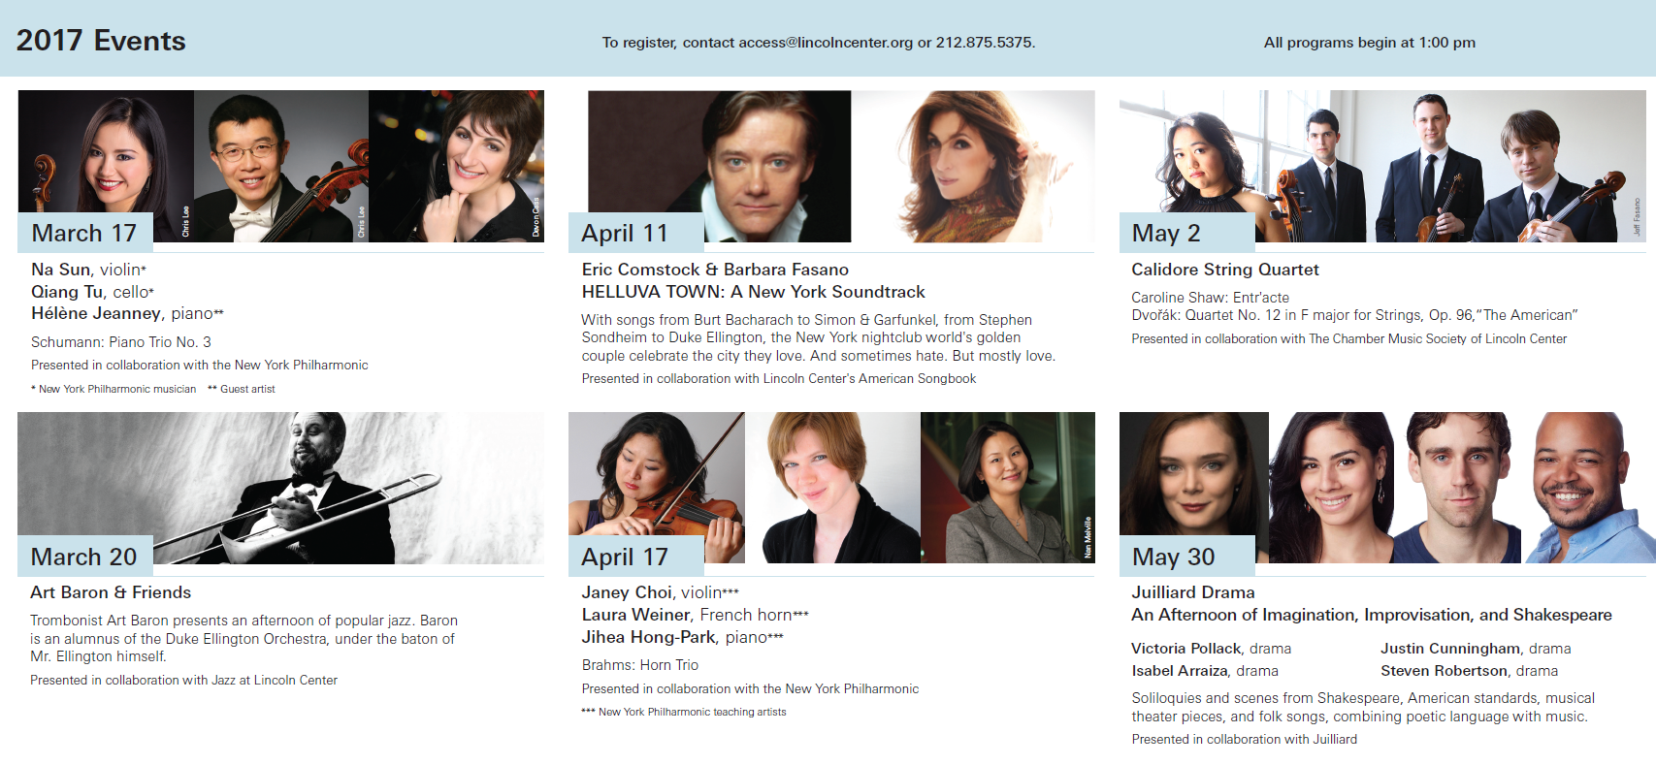

Slide 7
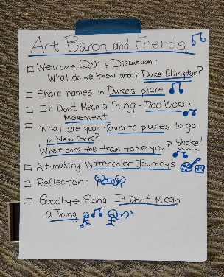
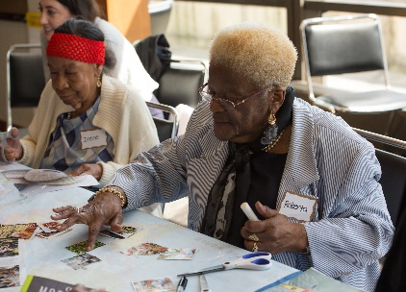
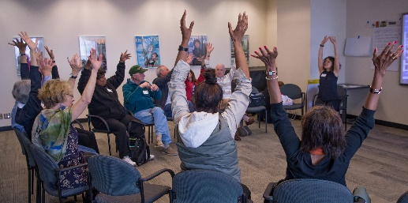
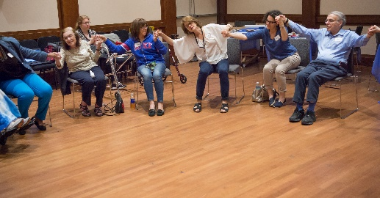
Program Template
Part 1: Performance
One hour
Includes introduction and Q&A with artists
Part 2: Workshop – small group
Open with discussion of performance
Warm-up with music and movement
Exploration of theme using images and open-ended prompting questions
Music-making
Art-making
Share

Slide 8
Lessons Learned
We couldn’t do it ourselves.
In some ways, we’re like museums, and in others, we’re not.
Audience is extremely diverse.
Music therapy vs. therapeutic techniques
Feedback is challenging, but vital.

Slide 9

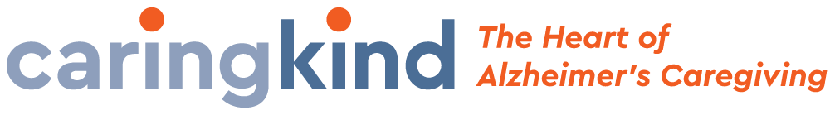
Lessons Learned
We couldn’t do it ourselves.
With Research and Training Support by:
With Training and Outreach Support by:

Slide 10
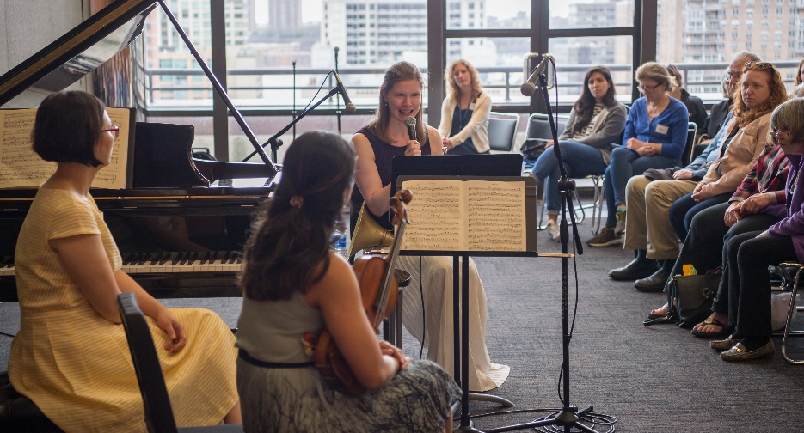
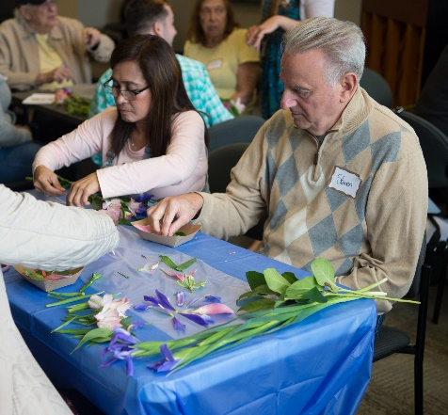
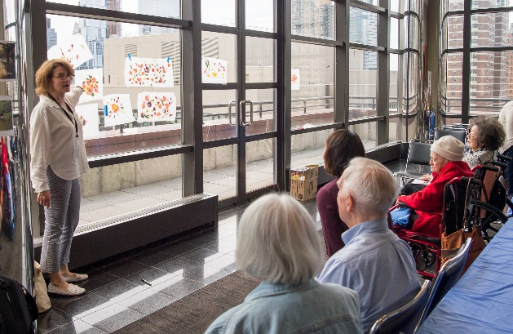
Lessons Learned
We couldn’t do it ourselves.
In some ways, we’re like museums, and in others, we’re not.

Slide 11
Lessons Learned
We couldn’t do it ourselves.
In some ways, we’re like museums, and in others, we’re not.
Audience is extremely diverse.
“And they really had a program for people who were really, very, totally out of it. And I found it depressing. Uh, that was a problem. And I remember talking to the person who was running it had no experience, and I said, “You really have to watch as you segment the groups because they’re not all the same.” And it really didn’t work for me. Sure, maybe others.”
“As they are set up now, much of what happens seems over the heads of much of the group. Your educators would know how this might be done.”
“This was a superb program. Strengths--the musicians conversation about the music as well as performance; workshop -great engagement of group with music and art, and art making; the leaders (yellow dot group) were very good at drawing out the group and synthesizing observations and responses.”

Slide 12
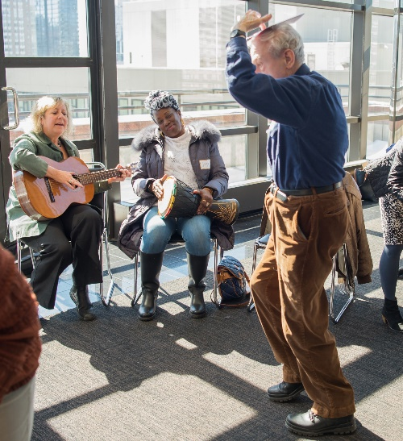
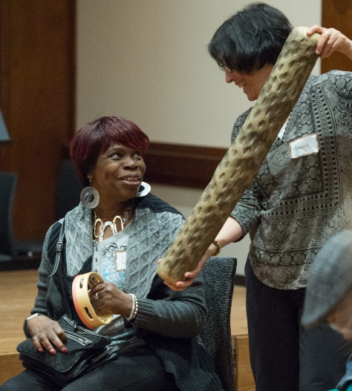
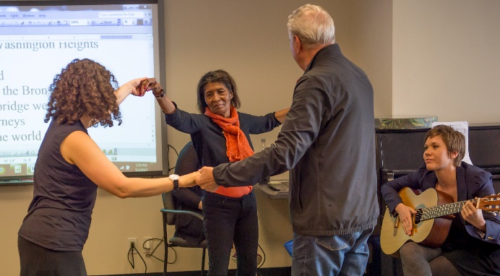
Lessons Learned
We couldn’t do it ourselves.
In some ways, we’re like museums, and in others, we’re not.
Audience is extremely diverse.
Music therapy vs. therapeutic techniques

Slide 13
Lessons Learned
We couldn’t do it ourselves.
In some ways, we’re like museums, and in others, we’re not.
Audience is extremely diverse.
Music therapy vs. therapeutic techniques
Feedback is challenging, but vital.
“I think that making music, writing poetry, and lyrics and stuff… to me for the, uh, Lincoln Center programs the art-making is the least interesting. Partly because there’s so many options and museums to do it. And, to me, it’s the music and the theater experience there that isn’t available anyplace else and has such a rich resonance on people with memory loss, so I think the more that can be done that way, from my standpoint, the more engaging.”
“Mom enjoyed it- she said so today and she said she had a good time and we have left the collage she made on the kitchen table where she refers to it at each meal!”

Slide 14
Next Steps
Completing Spring Season
Debrief with TA’s and Partners for recommendations for Year 3
Post-Season Focus Group
Research Results
Planning for 2017-18 Season/s

Slide 15
Thank you!
Miranda Appelbaum
Assistant Director, Accessibility & Guest Services
Lincoln Center for the Performing Arts
mappelbaum@lincolncenter.org

