Slide 1


Slide 2
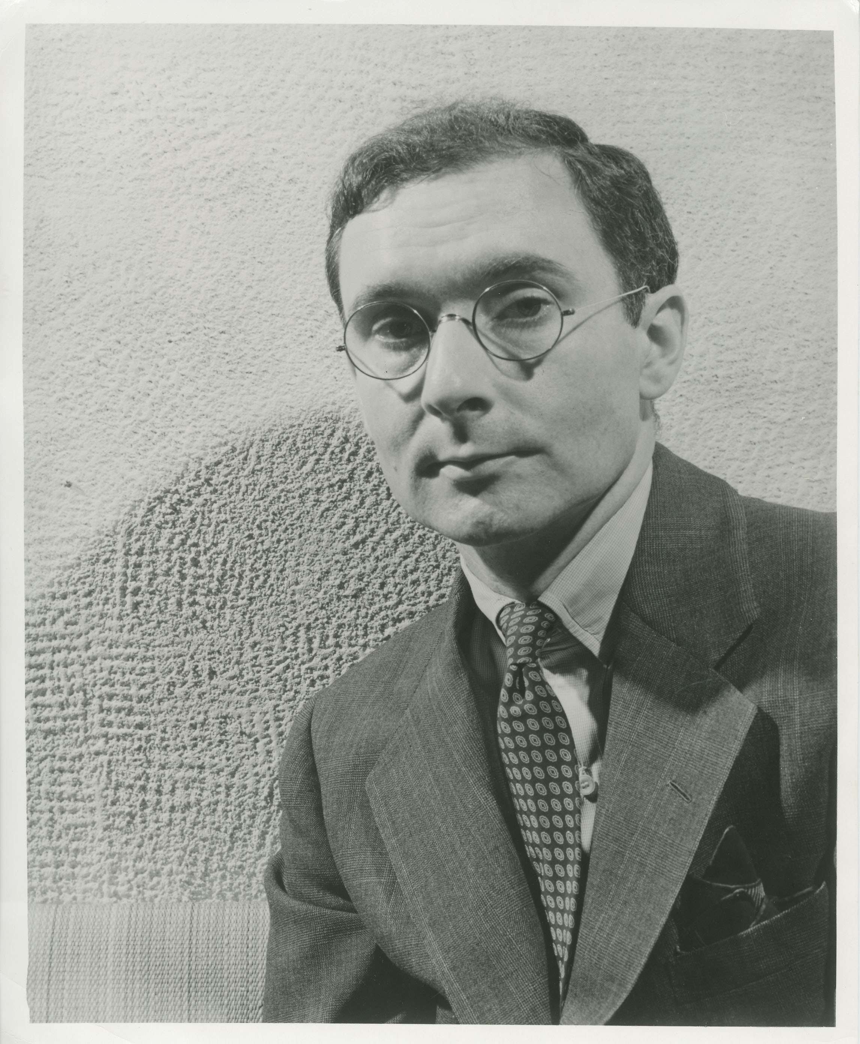
ENJOYING
UNDERSTANDING
USING

Slide 3


Slide 4
Debbie slide

Slide 5
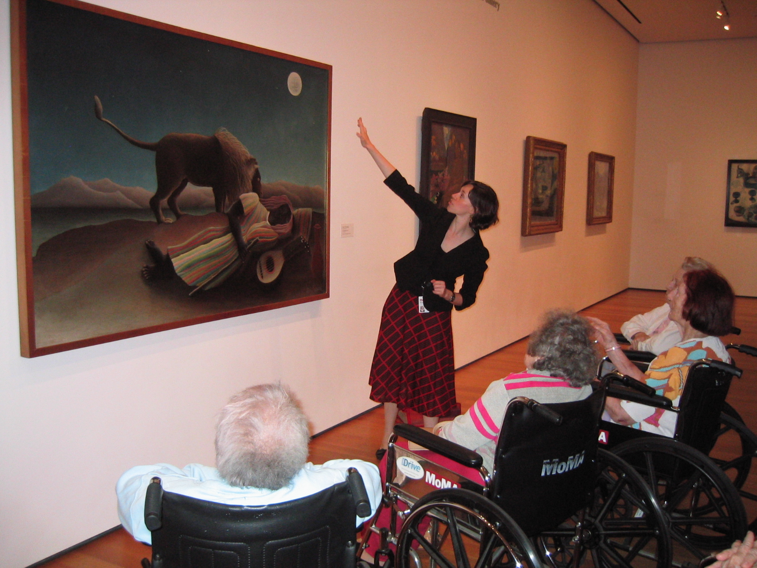

Slide 6
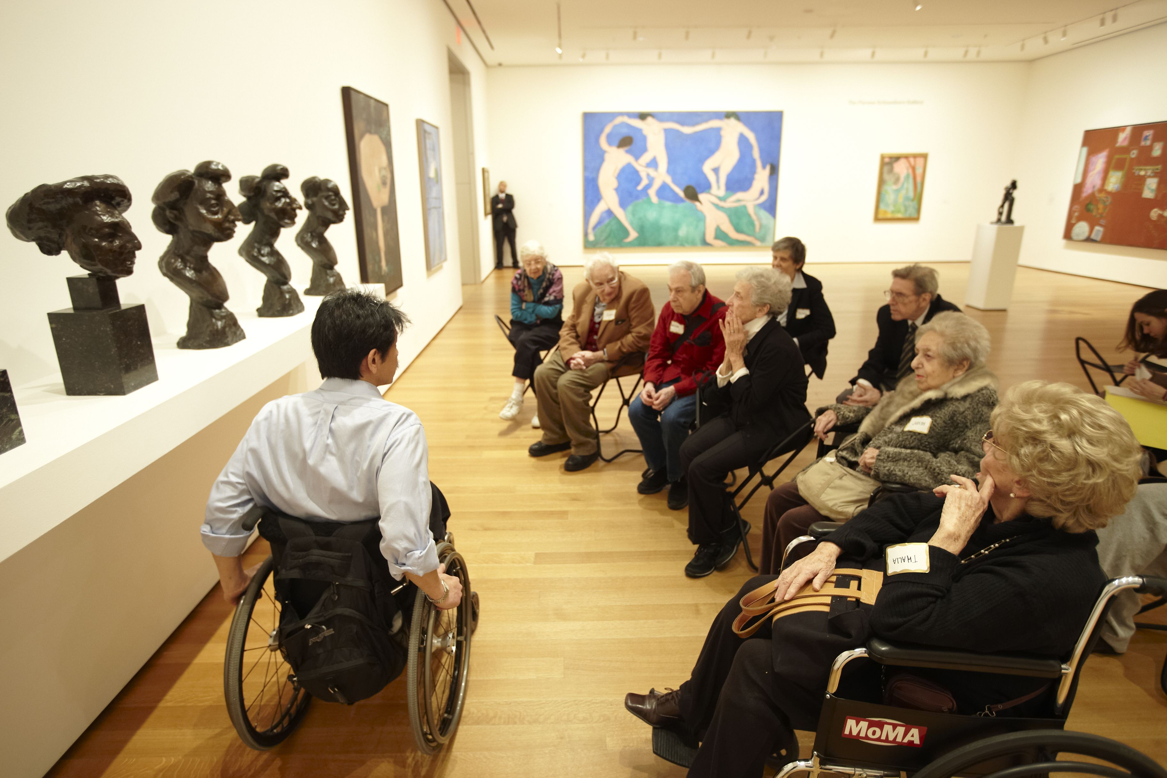

Slide 7
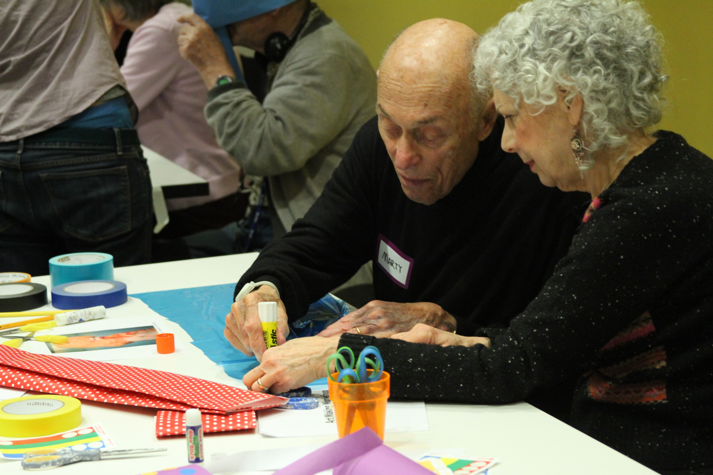

Slide 8
The MoMA Alzheimer's Project
Outreach: MoMA staff have worked with over 380 different museums and connected with over 13,000 people through conferences and trainings
Over 125 museums world-wide have committed to working with the audience with support provided by MoMA

Slide 9
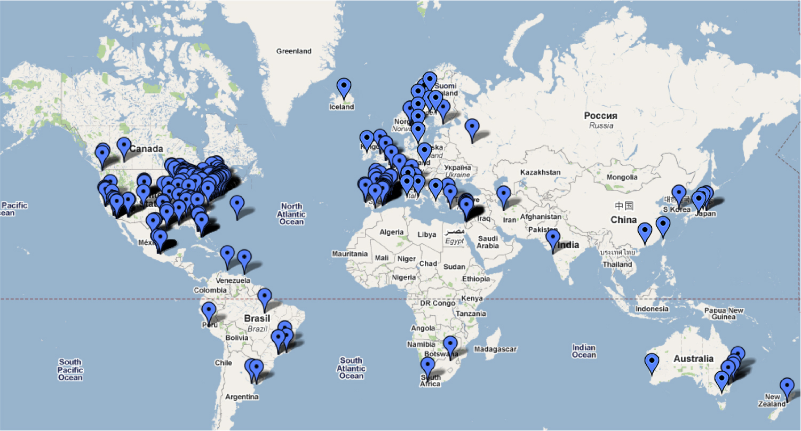

Slide 10
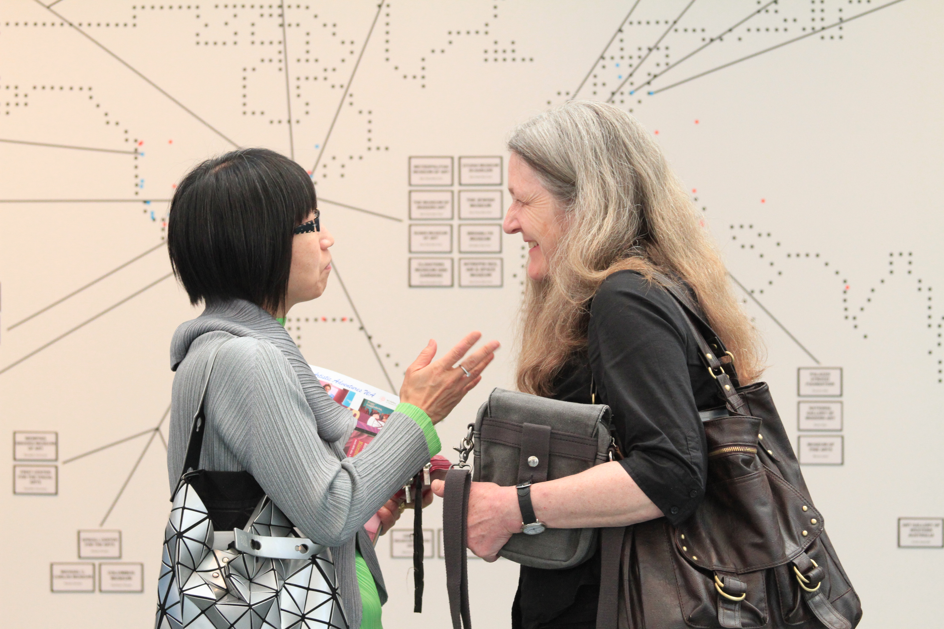

Slide 11
The MoMA Alzheimer's Project
Resources and Research

Slide 12
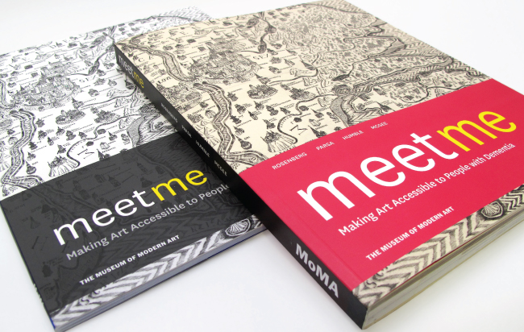

Slide 13

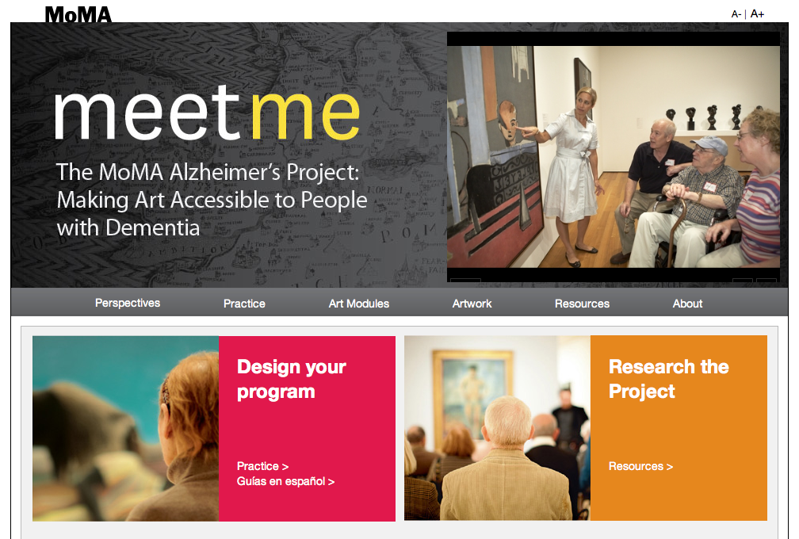

Slide 14
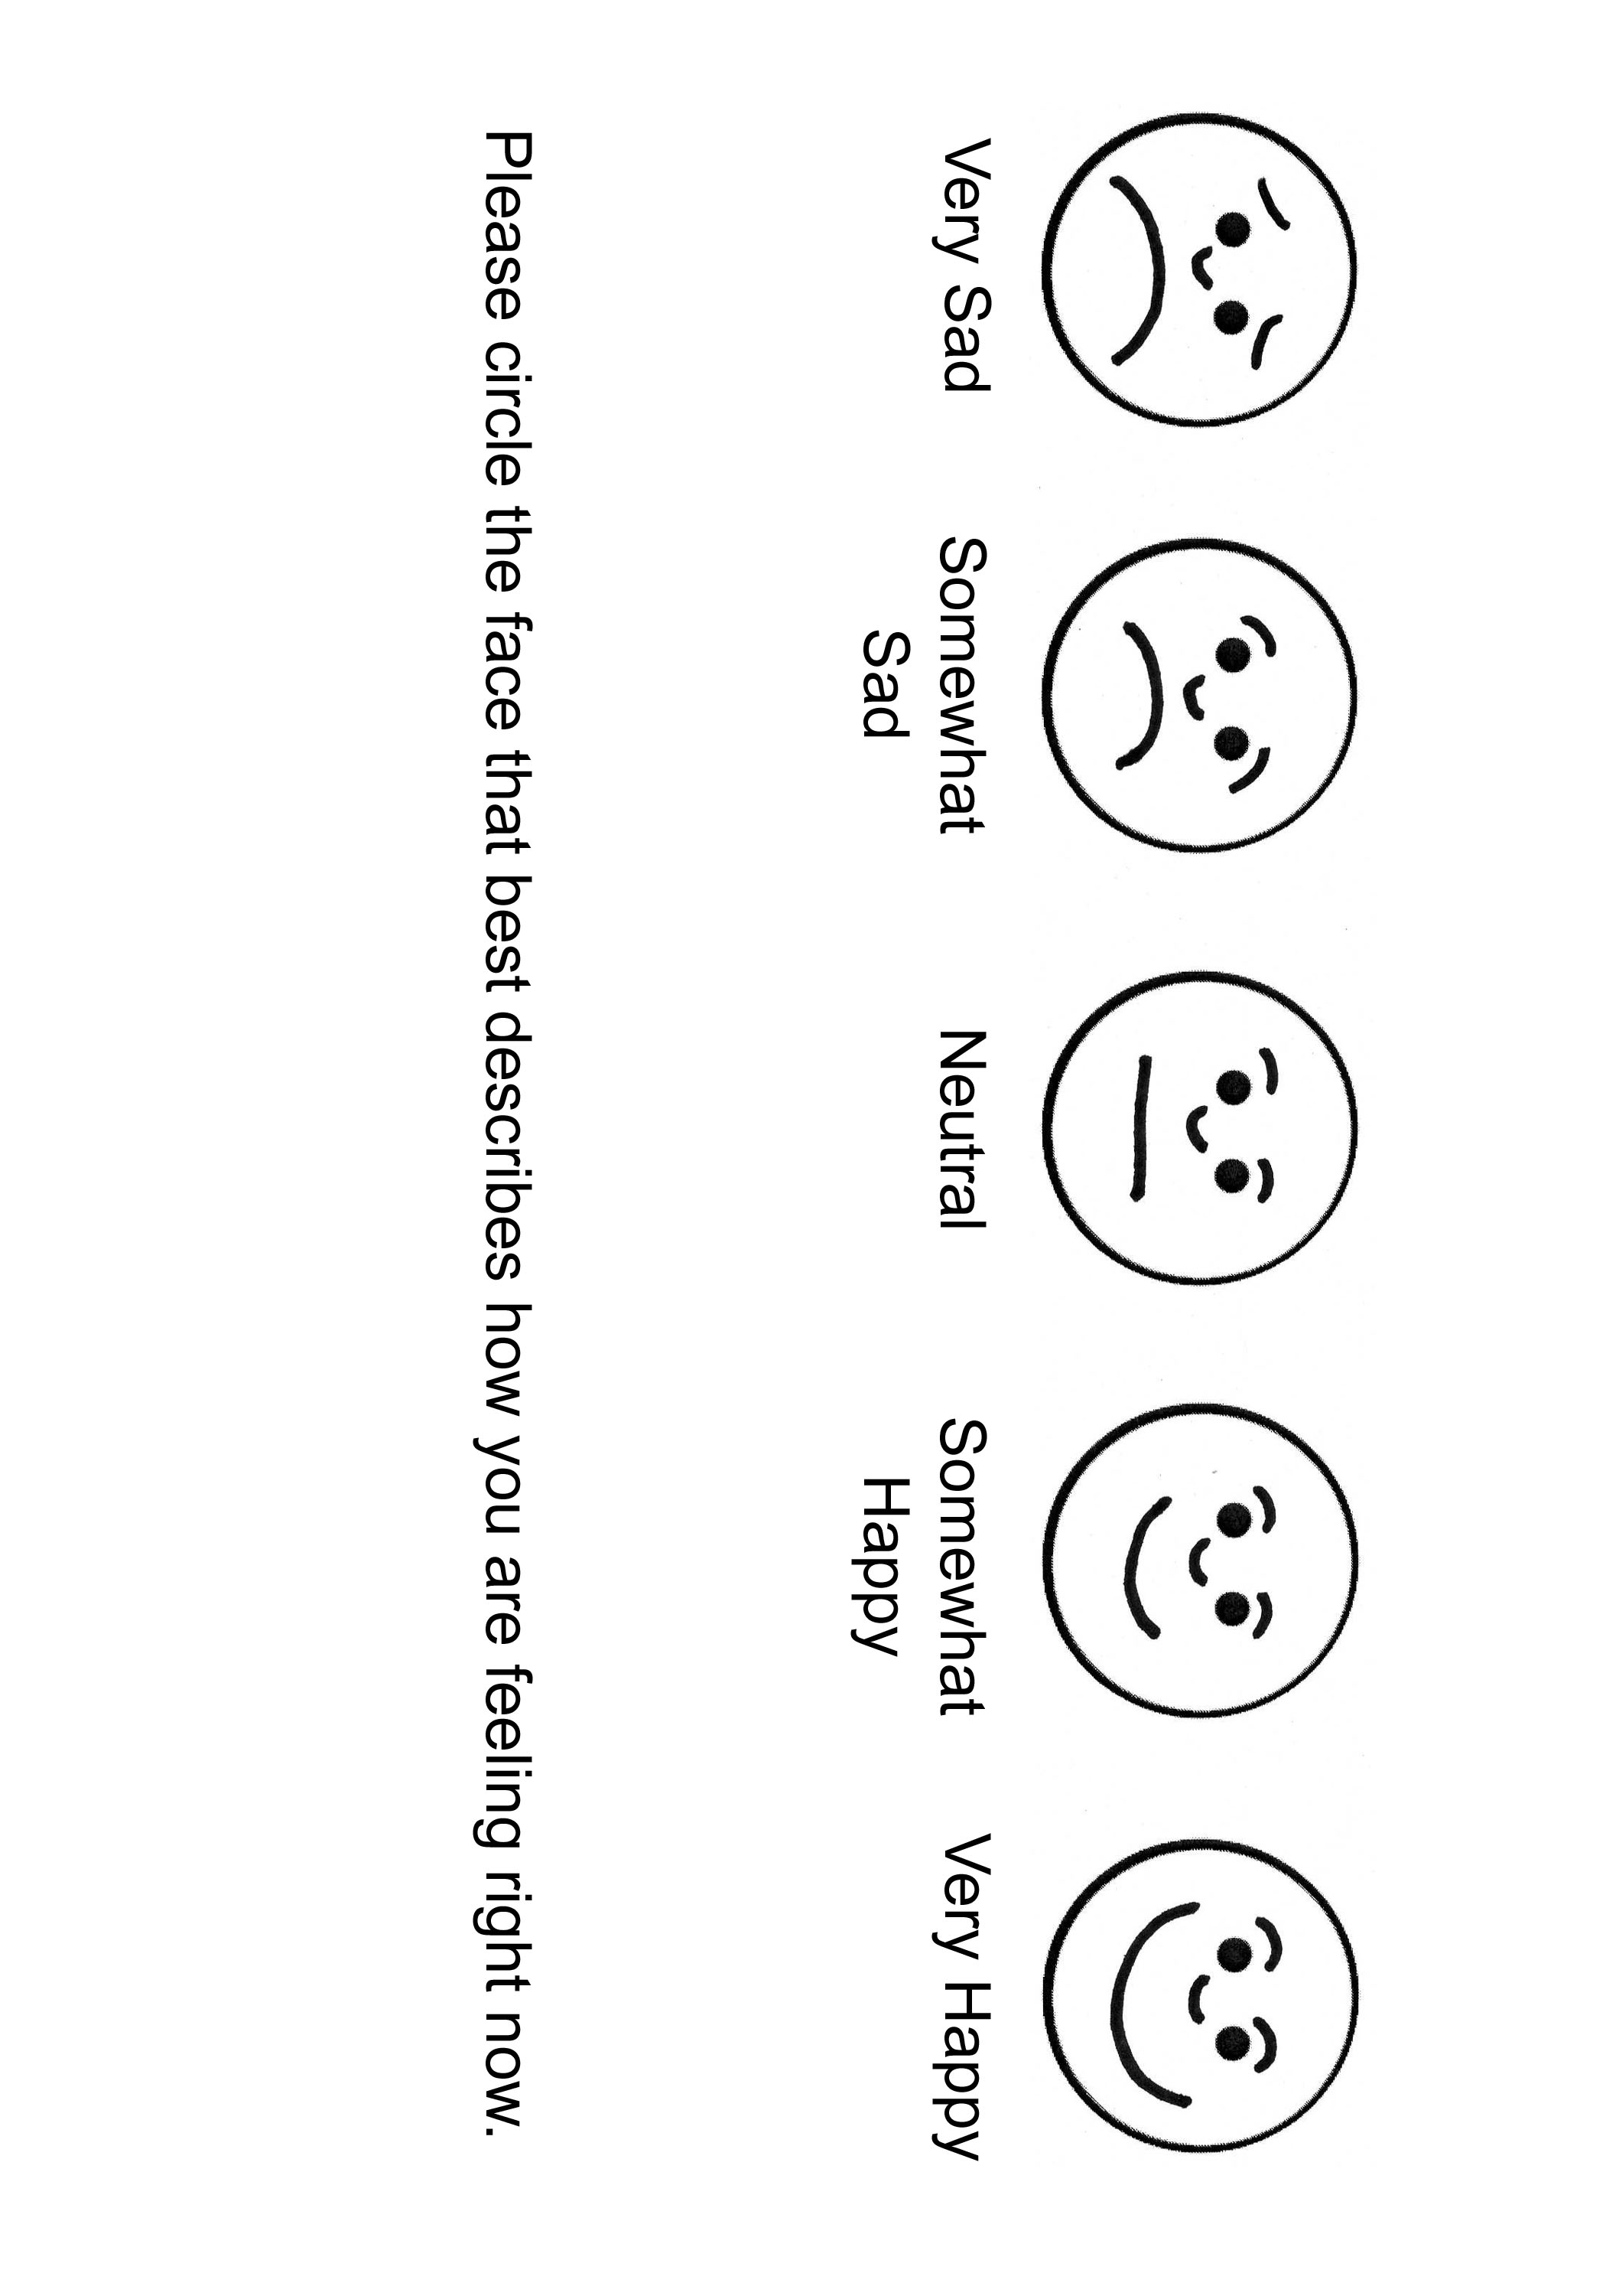
Research: NYU Center of Excellence for Brain Aging and Dementia

Slide 15
Must Haves
Importance of the Educator
Comfortable Environment

Slide 16
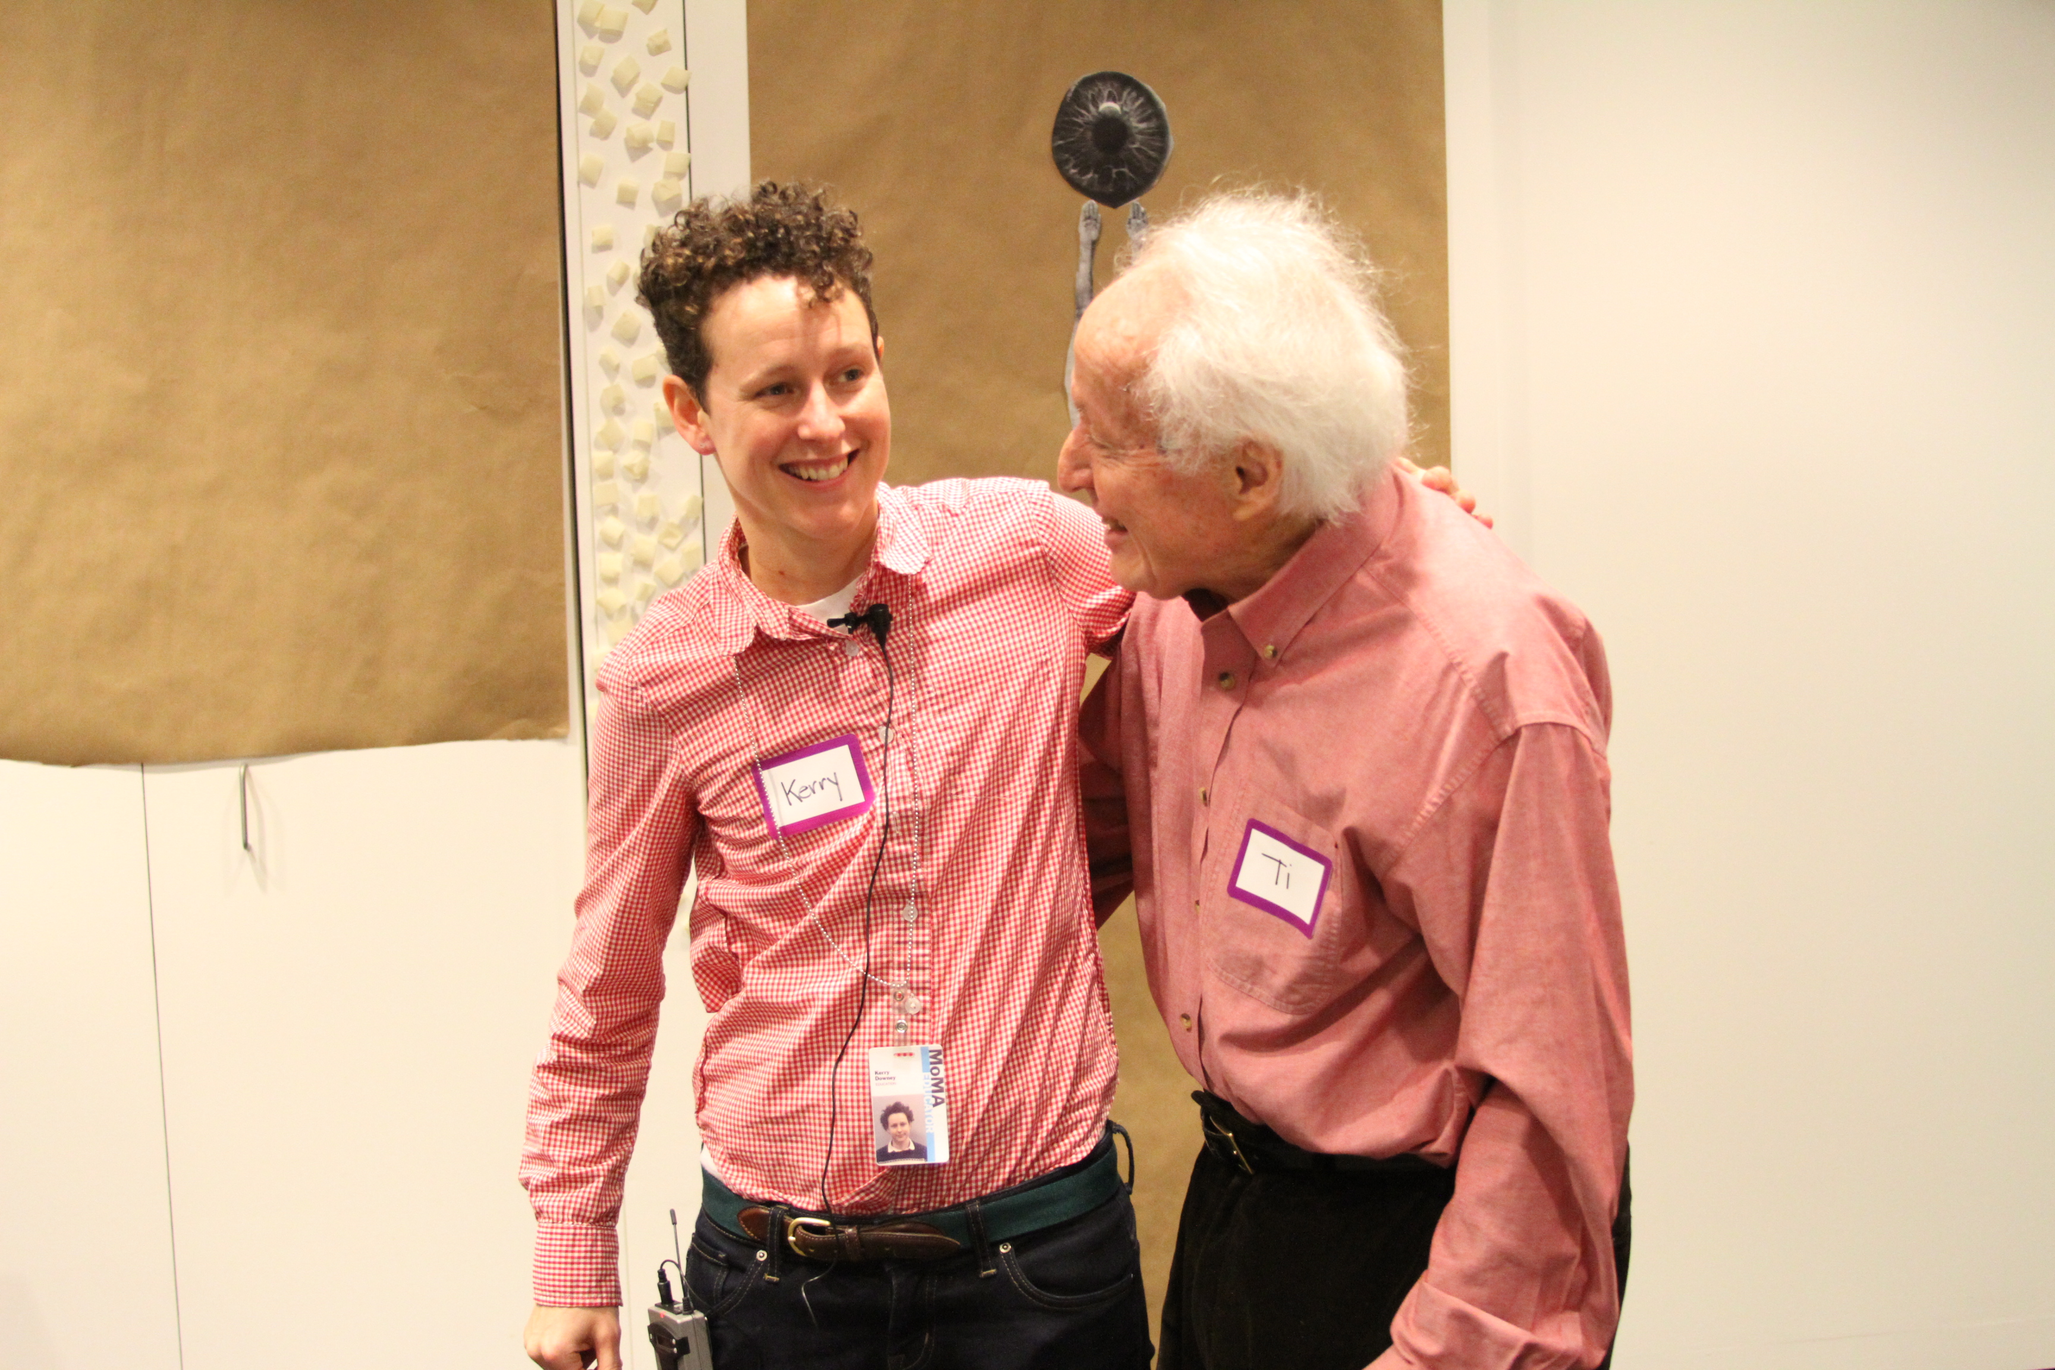

Slide 17
Challenges
Comfortable Environment
Abstract or Challenging Works of Art

Slide 18

Jackson Pollock
One: Number 31, 1950
1950

Slide 19
www.MoMA.org/meetme
Francesca_Rosenberg@moma.org

